Slide 1

Smart Bandwidth Allocation:
Using Machine Learning for Home Networks
Group Memeber: Yichong Liang, Ping Zhang

Slide 2
Agenda
1 Motivation
2 Related Work
3 Proposed Solution
4 Approach
5 Experiment
6 Conclusion
7 Future Work
8 Reference

Slide 3




1. Motivation - Problem Introduction
As home networks grow more complex with an increasing number of devices requiring bandwidth simultaneously, there arises a pressing need to manage and optimize bandwidth allocation efficiently.
11:00 pm
Day end
5:00 pm
Back home
5: 00pm - 6: 00 pm
Kids: ipad/switch Game
Parents: Making Dinner
6: 00pm - 7: 30 pm
Kids: smart TV time
Parents: Cleaning Housing
8: 30pm - 11: 00 pm
Kids: sleeping
Parents: Laptop web browsing
Weekdays Scenario: A family of Four, consisting of two adults and two children of varying ages, resides in a home.
Analyze Usage Pattern: How these five individuals use their internet devices throughout the weekdays?
Notes:
As home networks grow more complex with an increasing number of devices requiring bandwidth simultaneously, there arises a pressing need to manage and optimize bandwidth allocation efficiently.
Let's consider a scenario where a family of four, consisting of two adults and two children of varying ages, resides in a home. How these Four individuals use their internet devices throughout the 5:00 pm - 11: 00pm.
Based on these usage patterns, we dynamically allocate resources to the regularly used devices during specific time periods to enhance network resource utilization and improve user experience.

Slide 4
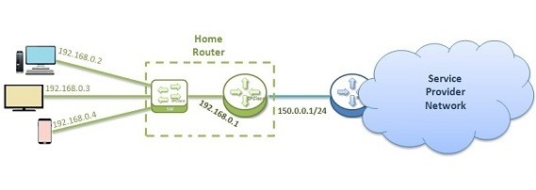
1. Motivation
User Experience：
Users may experience slow internet speeds due to inefficient bandwidth allocation.
There might be a lack of fairness in bandwidth distribution among family members, leading to frustration or conflict.
As more devices connect to home networks, users may find it increasingly difficult to manage their network settings manually.
Problems are not trivial！
User behavior is diverse
Bandwidth are continuously increasing
Manual adjustments to network settings
Notes:
The "people problem" typically relates to how the issue at hand affects users or stakeholders. For instance, in the context of smart bandwidth allocation using machine learning:
Users may experience slow internet speeds due to inefficient bandwidth allocation.
There might be a lack of fairness in bandwidth distribution among family members, leading to frustration or conflict.
As more devices connect to home networks, users may find it increasingly difficult to manage their network settings manually.
These problems are not trivial because:
User behavior is diverse and unpredictable, making static bandwidth allocation ineffective.
Manual adjustments to network settings are time-consuming and impractical for non-technical users.
The number of devices and the demand for bandwidth are continuously increasing, exacerbating the problem.

Slide 5
1. Motivation
Technical Problems：
Existing routers and network management systems not be sophisticated enough to dynamically allocate bandwidth based on real-time needs and predicted usage patterns.
Traditional network setups may not incorporate machine learning algorithms that can learn and adapt to user behavior over time.
Previous solutions may not scale well with the increasing number of devices and the complexity of network traffic.
Notes:
The technical problem often involves the limitations of current solutions in addressing the people problem effectively. For the smart bandwidth allocation:
Existing routers and network management systems may not be sophisticated enough to dynamically allocate bandwidth based on real-time needs and predicted usage patterns.
Traditional network setups may not incorporate machine learning algorithms that can learn and adapt to user behavior over time.
Previous solutions may not scale well with the increasing number of devices and the complexity of network traffic.
These technical issues prevent a trivial solution because:
Simple rules-based systems cannot capture the complexity and dynamic nature of modern home networks.
Upgrading network infrastructure to support better bandwidth management can be prohibitively expensive or technically challenging.
There is a need for intelligent systems that can operate autonomously, require minimal user intervention, and can adapt to changing network conditions.

Slide 6
2. Related work
Static Allocation
Lack of predictive capabilities to foresee and manage future network demands.
Priority queues
Inability to personalize bandwidth allocation based on individual user needs and preferences.
Basic Quality of Service (QoS)
Insufficient scalability or adaptability to new types of devices and services.
How can machine learning be applied to home networks to dynamically allocate bandwidth?
6
Notes:
Previous Solutions and Their Inadequacies:
such as static allocation, priority queues, or basic Quality of Service (QoS) settings in routers.
These might be inadequate due to:
Inflexibility in responding to real-time changes in network usage.
Lack of predictive capabilities to foresee and manage future network demands.
Inability to personalize bandwidth allocation based on individual user needs and preferences.
Insufficient scalability or adaptability to new types of devices and services.
The research question then focuses on how to overcome these inadequacies. It might be formulated as: "How can machine learning be applied to home networks to dynamically allocate bandwidth in a way that is fair, efficient, and responsive to the evolving patterns of user behavior?"

Slide 7
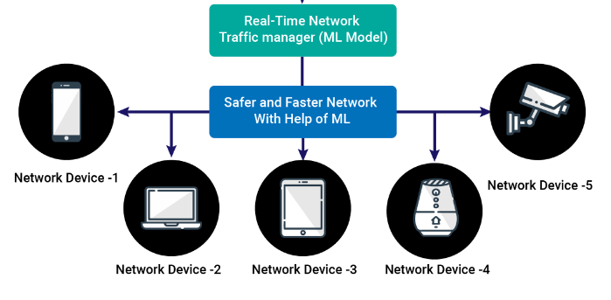
3. Proposed Solution
Smart bandwidth allocation: Employs machine learning techniques to analyze the usage patterns of a family's internet devices.
Analyzes: Captures real-time data on device activities, time of usage, and specific bandwidth heavy task (From Kaggle Website).
Predicts: Utilizes machine learning algorithms to anticipate the high bandwidth periods to enable pre-emptive allocation.
Optimizes: allocates bandwidth based on predicted needs, reducing lag and ensuring efficient network performance.
Adapts: As family behavior evolves, the mothod learns from new data and feedback.
Notes:
The proposed solution is a smart bandwidth allocation system that employs machine learning techniques to analyze the usage patterns of a family's internet devices. The hypothesis is that by understanding these patterns, the system can dynamically adjust the allocation of network resources to match the demand of each device at different times of the day, ensuring optimal bandwidth distribution.
Analyzes: Captures real-time data on device activities, time of usage, and specific bandwidth_x0002_heavy tasks, correlating them with specific family members’ habits.
Predicts: Utilizes machine learning algorithms to anticipate when high bandwidth periods
are likely based on family behavior, thus enabling pre-emptive allocation.
Optimizes: Dynamically allocates bandwidth based on predicted needs, ensuring highpriority tasks have necessary bandwidth, reducing lag and ensuring efficient network per_x0002_formance.
Adapts: As family behavior evolves, the system learns from new data and feedback. It refines its predictions and bandwidth allocation strategies to better serve the evolving needs of the family.

Slide 8
3. Proposed Solution
Scale:
Machine Learning Integration: not aim to integrate complex Machine learning models, as the focus is on use existing lightweight machine learning algorithms suitable for home networks.
Specific Content Prediction: not predicting the specific content that users might access, only bandwidth allocation prediction.
Infrastructure Overhaul: not intend to replace or drastically modify existing home network infrastructure but rather aims to enhance its performance.
Addressing Wide Area Networks: not addressed challenges specific to wide area networks or large-scale infrastructures are, centered on home networks.
Manual Allocates Bandwidth: not deploying bandwidth management software to wifi ruter (for now), not combined network software with ML to do dynamic allocation.
Notes:
Project Solution Scale:
Machine Learning Integration: The project does not aim to integrate complex deep learning models, as the focus is on lightweight machine learning algorithms suitable for home networks.
Specific Content Prediction: The primary objective is bandwidth allocation, not predict_x0002_ing the specific content that users might access.
Infrastructure Overhaul: The project does not intend to replace or drastically modify existing home network infrastructure but rather aims to enhance its performance.
Addressing Wide Area Networks: The project is centered on home networks, so chal_x0002_lenges specific to wide area networks or large-scale infrastructures are not addressed.
Manual Allocates Bandwidth：Because our current experiments are conducted on simulations of NS-3，So not including deploying to wifi ruter, not combined network software with ML to do dynamic allocation.

Slide 9
4. Approach
Data Collection & Data Cleaning
Real time Data( Kaggle)
Track device usage: Random usage && Pattern usage
Data Cleaning using Python
Establish bandwidth demand baseline
device usage data
Developed ML models: Random Forest, SVM, Logistic
Train with Pattern usage historical data
ML models Selection: Random Forest
Validate bandwidth predictions and refine model
Machine learning Model Development
Python (Ski-Learn)
bandwidth predictions
Random usage scenario : Bandwidth allocation without predictions result, collection device usage data on NS-3 simulation
Pattern usage scenario : Bandwidth allocation with predictions result, collection device usage data on NS-3 simulation
Bandwidth Management
NS-3 Allocation
device usage data
Evaluation &
Conlusion
Evaluation metric
Evaluation Machine Learning impact: Latency, F1_Score
Compare evaluation metric of Random VS Pattern: F1_Score
Notes:
Step1 : Data Collection: Monitor real-time (NS-3) network traffic, device usage rates, and active times to understand bandwidth demand.
Step2 : Mahine Learning Model : Incorporate ML model to predict bandwidth requirements based on Pattern usage historical and real-time data.
Step3 : Bandwidth Management: Dynamically allocate bandwidth to devices based on Pattern usage predicted demand, ensuring optimal distribution.
Step4 : "Evaluation consists of two parts. The first part is to compare the Latency of Random usage with the Latency of Pattern Usage.
The second part of the evaluation uses the data results from NS-3 simulations to inversely validate the Machine Learning Model, resulting in an F1_Score to assess the model's accuracy.
The expected result is that the Latency of Pattern Usage is less than the Latency of Random usage. Beside, The F1_score nearby 1.

Slide 10
5. Experiment - Contrast Scenario
Contrast Experimental scenario Design: Random Scenario VS Pattern Scenario
Device | IP Address | Usage Periods | Application
smart TV | 192.168.239.12 | 5:00 pm - 11:00 pm | Streaming
iPad | 192.168.239.7 | 5:00 pm - 11:00 pm | Streaming and web browsing
iPhone | 192.168.239.67 | 5:00 pm - 11:00 pm | Streaming
Laptop | 192.168.239.95 | 5:00 pm - 11:00 pm | web browsing
Device | IP Address | Usage Periods | Application
smart TV | 192.168.239.12 | 6: 00pm - 7: 30pm | Streaming
iPad | 192.168.239.7 | 5: 00pm - 6: 30pm | Streaming and web browsing
iPhone | 192.168.239.67 | 7: 30pm - 11: 00 pm | Streaming
Laptop | 192.168.239.95 | 8: 30pm - 11: 00 pm | web browsing
Random Scenario : Within the home network, multiple devices are used indiscriminately with no clear distinction in usage periods, randomly being used between 5:00 PM and 11:00 PM.
Pattern Scenario : Within the home network, multiple devices have distinct usage periods, being used between 5:00 PM and 11:00 PM.
Notes:
We developed two different scenarios for our solution our ideas to test on
4 devices, diverse behavior
Random: after I have dinner I have my tv playing youtube but I will also browsing my phone
Pattern: obviously the usage of the network have it’s patterns on behaviors

Slide 11
5. Experiment - ML Model Building
Data
Input X
Models Training
Hour
Device IP
Training Data
Classification Algorithm:
Random Forest
SVM
Logistic
Six Days:
Day1: 5:00 pm -11:00pm
Day2: 5:00 pm -11:00pm
Day3: 5:00 pm -11:00pm
Day4: 5:00 pm -11:00pm
Day5: 5:00 pm -11:00pm
Day6: 5:00 pm -11:00pm
F1
S
o
c
r
e
Data Cleaning
Model
Biulding
Model
Evaluation
Target Y
Packet Length Range
Models Test
Test Data
Packet Length Range:
0-300 | 301-800 | 801-4000 | 4001-8000
Web Browsing | Web Browsing | Streaming | Streaming
iPad/iPhone | Laptop | iPad/iPhone | Smart TV
Notes:
We split the data we got from Kaggle into 6 days
Data cleaning to get the data we need to tune the ML model
Packet range: 0-300 for ipad iphone for some basic web browsing, laptop 300-800 for maybe heavier browsing tha might contain images
800-4000 for streaming on ipad iphone which is quite enough for some youtube or short video
4000-8000 for TV for heavy streaming
Since the packet size can be vary by a lot even under the same network behavior, so we decided to use classification instead of regression

Slide 12
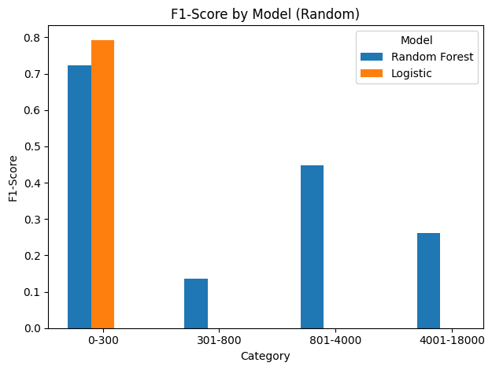
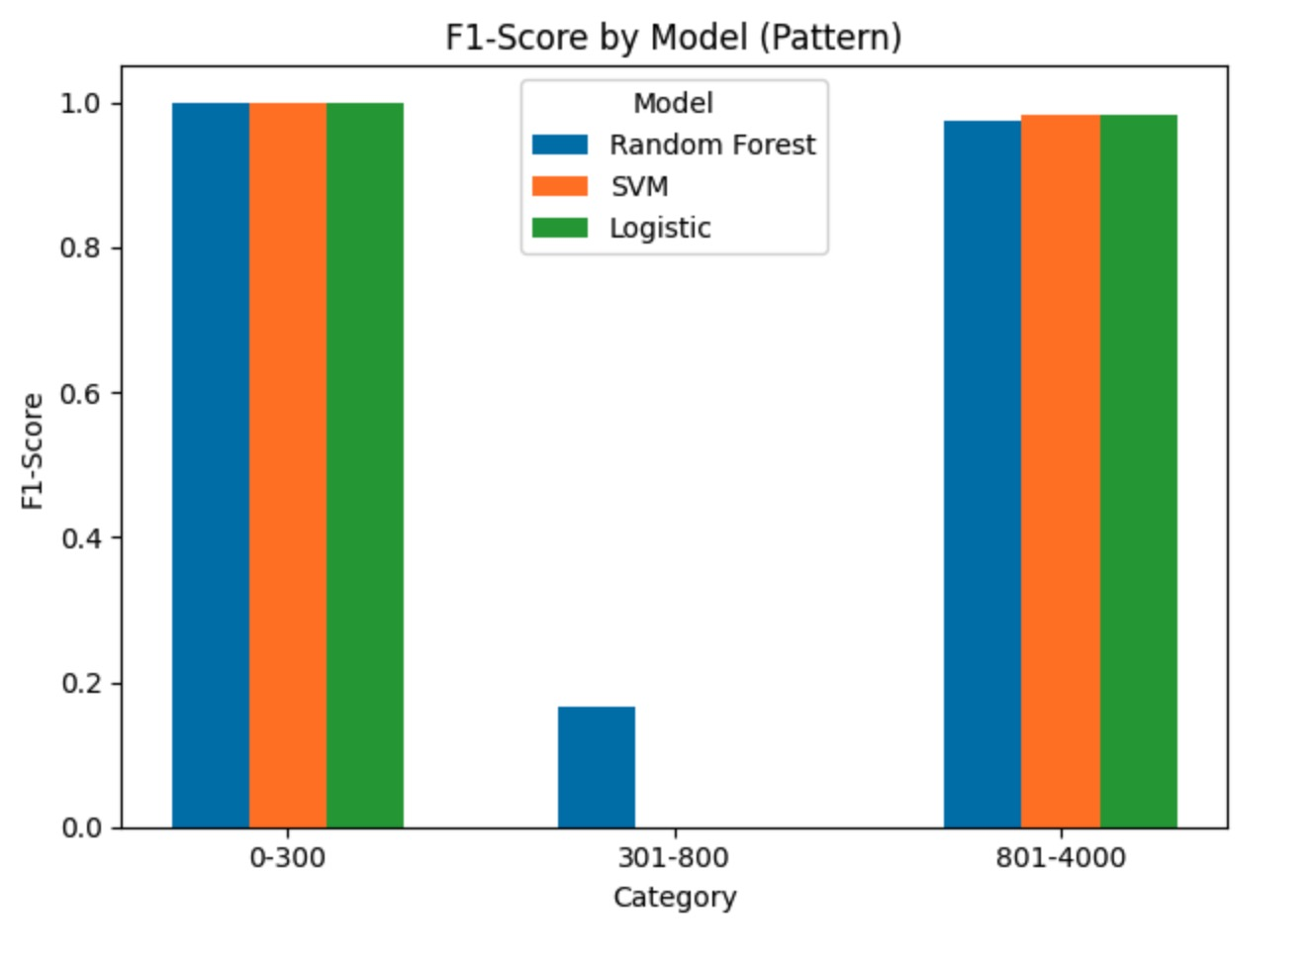
5. Experiment - ML Model Evaluation
ML Model Selection :
Random Forest For Pattern Usage Model
ML model no impact for Random Usage
Notes:
The results came out from ML model no surprise
For random behavior scenario all the classification models result is not ideal, SVM wasn’t been listed because it takes forever to run the SVM
For pattern behavior scenario all three have quite ideal outcome from the models. Random forest have better result covering all category, so we have chosen it

Slide 13
5. Experiment - NS3 Set Up
Common parameters:
1. Node Configuration:
WiFi Station Nodes (Devices): 2 & 4 nodes created
WiFi Access Point Nodes: 1 node created
2. Channel and PHY Settings:
Propagation Delay Model: ConstantSeedPropagationDelayModel
Propagation Loss Model: FriisPropagationLossModel
3. Mobility Configuration:
Positioning Grid: 0.0 for X and Y starting position, 5.0 meters apart
4. IP Addressing:
IP Base: 192.168.239.0
Subnet Mask: 255.255.255.0
5. Simulation Time:
Duration: 900 Seconds (15 minutes)

Slide 14
5. Experiment - NS3 Set Up
Differentiating parameters
Pattern Scenario :
1. WiFi Configuration:
Standard: WIFI_STANDARD_80211b
Data Rate: Dsss Rate 1Mbps with no allocation
Dsss Rate 5.5Mbps with allocation
2. Traffic Configuration:
Server Port: 9
UdpEchoClient for iPad:
IP: 192.168.239.5
MaxPackets: 900
Interval: 1 Sec
PacketSize: 1024 Bytes
UdpEchoClient for Smart TV:
IP: 192.168.239.4
MaxPackets: 960
Interval: 1 Sec
PacketSize: 2048 Bytes
Random Scenario :
1. WiFi Configuration:
Standard: WIFI_STANDARD_80211b
Randomly assigned Data Rates:
Dsss Rates 1Mbps, 2Mbps, 5.5Mbps, 11Mbps
2. Traffic Configuration:
Server Port: 9
UdpEchoClient for iPad:
IP: 192.168.239.5
Interval: 0.1 Sec
PacketSize: 1024 Bytes
UdpEchoClient for Smart TV:
IP: 192.168.239.4
Interval: 0.1 Sec
PacketSize: 2048 Bytes
UdpEchoClient for Laptop:
Interval: 5 Sec
PacketSize: 512 Bytes
UdpEchoClient for Cell Phone:
Interval: 1 Sec
PacketSize: 256 Bytes
Notes:
Having troubles running ns3 simulation for 6 hours and setting up the number of packets. My computer won’t let me set packet more than 1000 even though the max packet ns3 allow is much more
So that I can only run 2 devices that use period overlap and need larger bandwidth. #5:52pm - 6:07pm 6:00pm - 6:07pm
Data rate 1 mbps no allocation, 5.5 mbps with allocation
Random scenario also not able to run full 6 hours but not particular important in this scenario for time period since all thing can happen

Slide 15
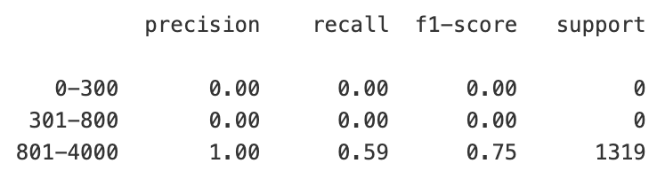
5. Experiment - NS3 Evaluation
 | Without Allocation (Sec) | With Allocation (Sec) | % of Improve
iPad | 0.12706 | 0.00506 | 96.02%
Smart TV | 0.00475 | 0.00430 | 9.47%
Bandwidth Prediction on Pattern Scenario
Notes:
After we have the simulation results, we analyze the pcap network traffic file output from ns3
After analysis data cleaning we calculate the initializing latency of each devices
This not the average latency.
Comparing to the result without allocation and with allocation we can notice that there is significant improvement on pre-allocating the device to have higher bandwidth
For ipad it have 96% improvement and smart tv at about 10% improve
which is quite a lot improving for ipad
For the machine learning prediction since I only able to input 2 devices to predict so it may affect our prediction
so that the classification report doesn’t look perfect, but the quite decent score
Also since I not able to get the random scenario simulation output correctly so I wonder able to compare the allocated and not allocated prediction result
But from the model training result we can almost say that random scenario won’t get pretty result

Slide 16
6. Conclusion
ML prediction result is promising on pattern usage scenario
ML prediction will have no impact on random usage scenario
96% latency reduction on initiating the connection of the iPad
9.5% latency reduction on initiating the connection of the Smart TV
Pattern behavior scenario in home network will be benefitted from the proposed solution
Random behavior scenario in home network might not be benefit from the proposed solution
From the given result it does help the network to be more efficient in specific scenario
Notes:
Pattern Decent score, model training looks great

Slide 17
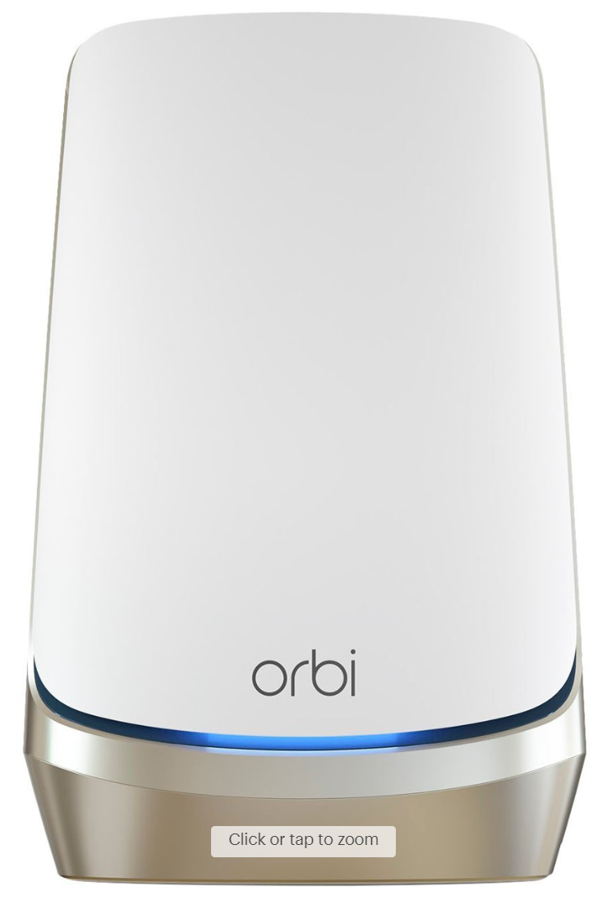
7. Future Work
Automatically update the Machine Learning model through New data is collected regularly
Combining network software with Machine Learning prediction result to do dynamic allocation
Deploying network management software to WIFI router
Software:
Data Collection
periodically
ML Model
Prediction
Result
Bandwith
Allocation
Automatically
WIFI
Router
Hardware
Support Embed Software
Data transfer to Software

Slide 18
8. Reference
[1] J. A. Hatem, A. R. Dhaini, and S. Elbassuoni. Deep learning-based dynamic bandwidth allo_x0002_cation for future optical access networks. IEEE Access, 7:97307–97318, 2019.
[2] Can Wang, Sheng Zhang, Yu Chen, Zhuzhong Qian, Jie Wu, and Mingjun Xiao. Joint config_x0002_uration adaptation and bandwidth allocation for edge-based real-time video analytics. pages
257–266, 2020.
[3] N. Navabhaarathi, "Network traffic analysis," Kaggle, 2023. [Online]. Available: https://www.kaggle.com/datasets/navabhaarathi20003/wireshark2/.

Slide 19
Thank You!
Questions? Thoughts?

